Slide 2
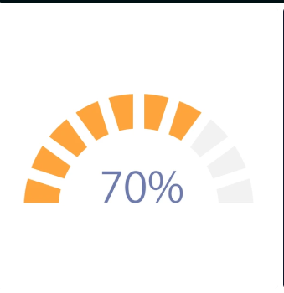
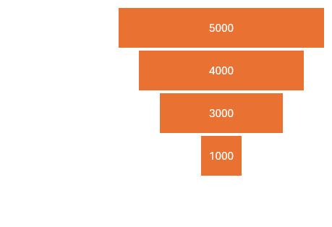
Customer Satisfaction Rate (% of Positive Reviews)
Ad Interaction Rate (% of viewers
who engaged)

Slide 3
"Impact of Advertising Investment on Ticket Sales"

Slide 4
